Slide 1

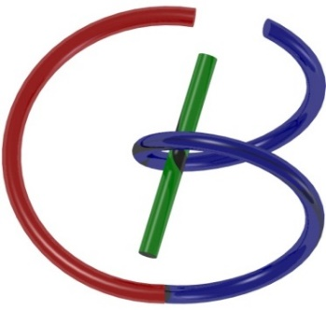

Spin-Echo
Ge Wang
AI-based X-ray Imaging System (AXIS) Lab
Rensselaer Polytechnic Institute, Troy, New York, USA
October 15, 2021

Slide 2
MI Schedule for F21
Tue | Topic | Fri | Topic
08/31 | Introduction | 09/03 | Neuron, Network & Backpropagation
09/07 | No Class | 09/10 | Hands-on 1: Python, Colab, & TensorF
09/14 | Architectures & Training | 09/19 | Hands-on 2: MNIST Classification
09/21 | Image Quality I | 09/24 | CT Physics
09/28 | CT Reconstruction | 10/01 | Deep CT Reconstruction
10/05 | Hands-on 3: CT Networks | 10/08 | More CT Contents
10/12 | MRI Physics | 10/15 | Spin-Echo
10/19 | K-Space Theorem | 10/22 | More MRI Contents
10/26 | Mid Exam | 10/29 | Deep MRI Reconstruction
11/02 | Hands-on 4: MRI Networks | 11/05 | Nuclear Physics
11/09 | Nuclear Imaging | 11/12 | US Imaging
11/16 | Optical Imaging | 11/19 | Multimodality Imaging
11/23 | Hands-on 5: Image Conversion | 11/26 | Thanksgiving
11/30 | Image Quality II | 12/03 | Stability, Interpretability, & Others
12/07 | Overview | 12/10 | Final Exam
Office Hour: Teaching Day 5-6pm: https://rensselaer.webex.com/meet/wangg6

Slide 3
Outline
Magnetization Vector
Bloch Equation, T1 & T2
Spin Echo

Slide 4
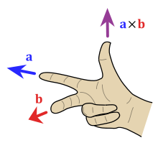
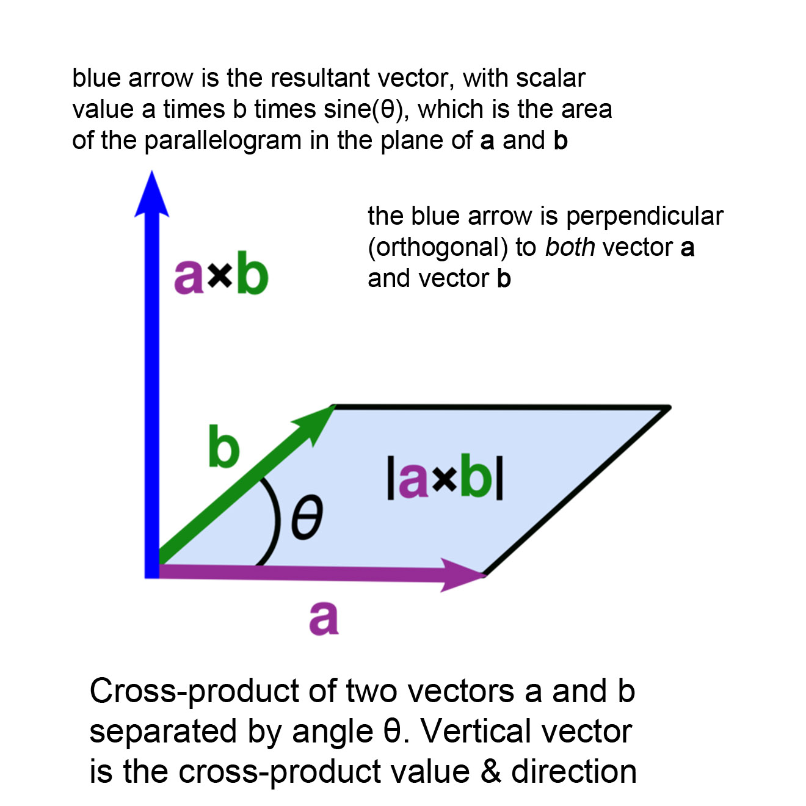
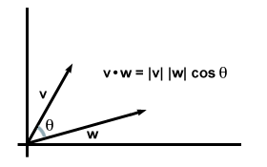
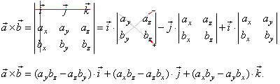
Math Operations: Dot & Cross Products

Slide 5
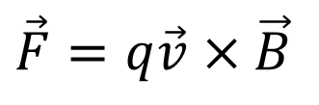
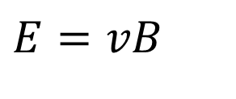
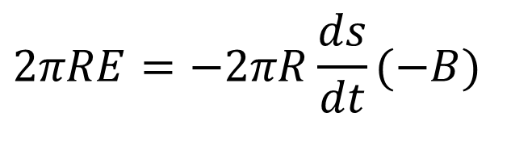
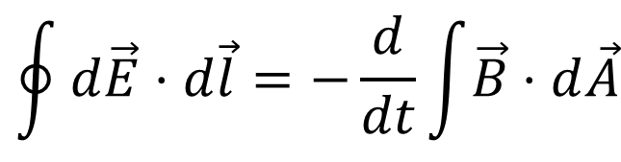
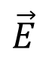
Ge’s Explanation
$$\vec{E}$$
$$\oint{d\vec{E}⋅d\vec{l}=−\frac{d}{dt}}\int{\vec{B}⋅d\vec{A}}$$
Faraday's Law
Lenz’s Law
$$2πRE=−2πR\frac{ds}{dt}(−B)$$
Symmetry (dA opposite of B)
$$E=vB$$
Elimination
$$\vec{F}=q\vec{v}×\vec{B}$$
Vectorized
Actually, the above steps only compute the tangential component. Any E component along the motion direction? How about charges move along a circle?

Slide 6
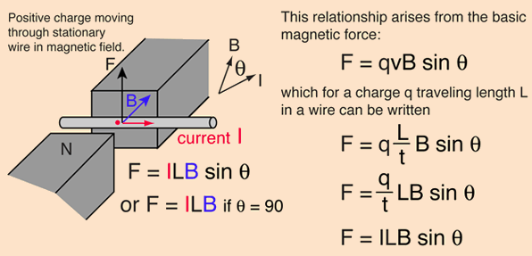
Lorentz Force on Conducting Wire
Orthogonal Component

Slide 7
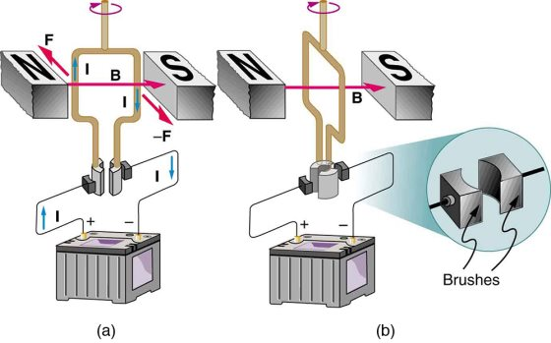
Torque on a Rectangular Loop
α=90˚
α=0˚
M
L
Torque τ = I*LMsinα*B (A=LM: loop area; Msinα=2(0.5Msinα))
Magnetic moment μ = I*A (Product of current and area is defined as magnetic moment with direction determined by the right-hand rule, true for any shape). τ = μ*B*sinα
τ = μ X B (Vectorized, cross product, to align up with B)

Slide 8
Key Points on Magnetic Moment
Magnetic moment is associated with a current loop and defined as a vector with its magnitude proportional to the current around the loop and the area of the loop and its direction determined by the right-hand rule
Torque τ = μ X B acts upon the magnetic moment, with its magnitude proportional to the magnetic moment magnitude, the field strength, and the sine of the angle between μ and B
Torque on the magnetic moment tends to align it with the direction of the magnetic field

Slide 9
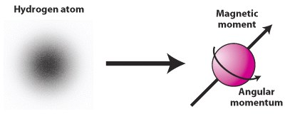
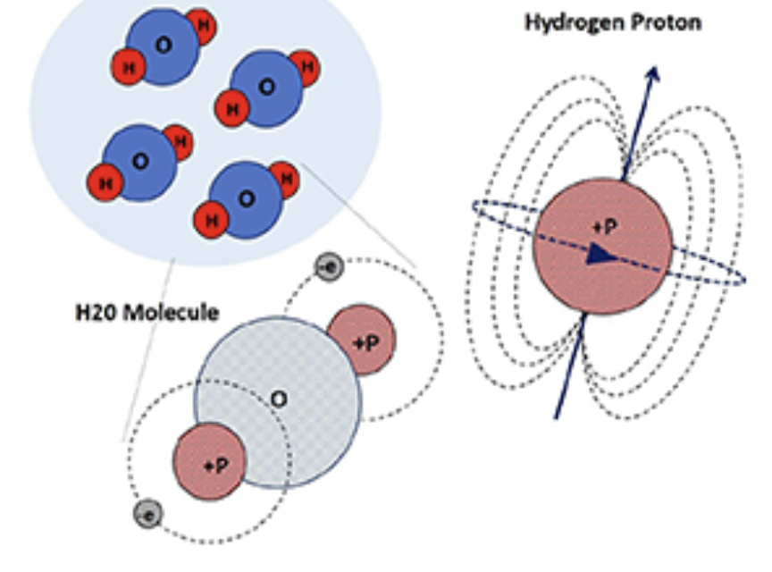
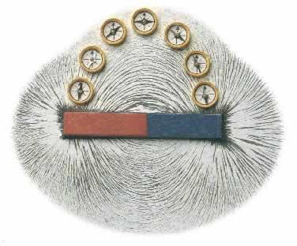
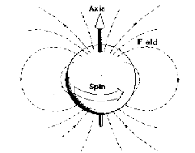
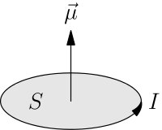
Mechanical & Magnetic Coupling

Slide 10
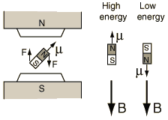
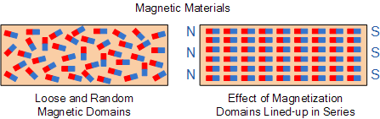
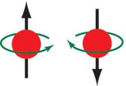
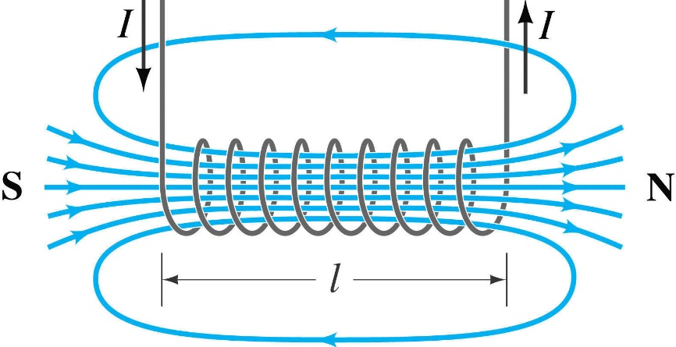
Magnetic Moment µ & Angular Momentum P
µ=γP
Proton has both magnetic moment µ and angular momentum P
µ in the magnetic field is subject to torque
Torque acts upon P
Both µ and P are in precession
Precession returning to the stable status,
emitting radio frequency (RF) signals

Slide 11
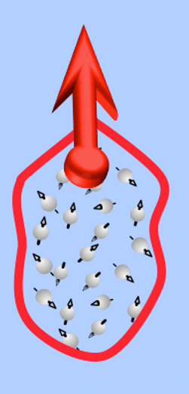
M: Magnetization

Slide 12
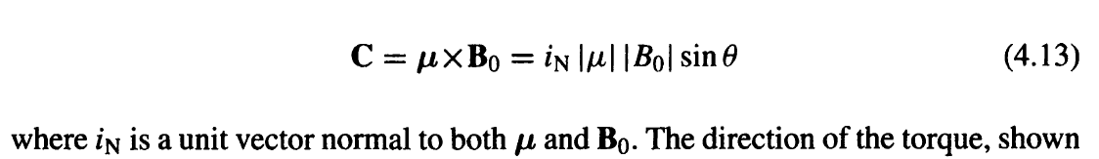
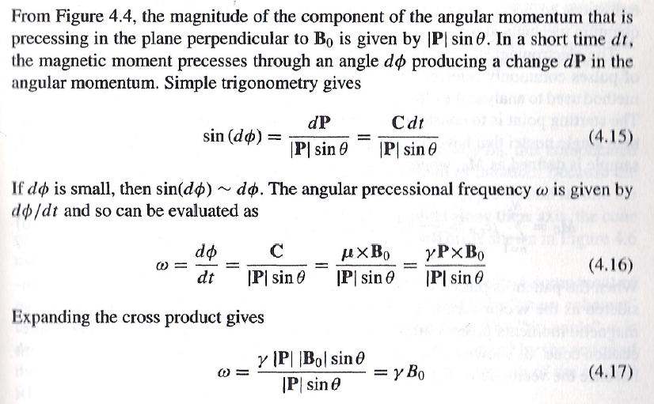
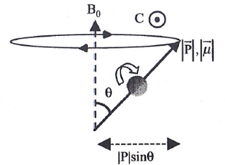
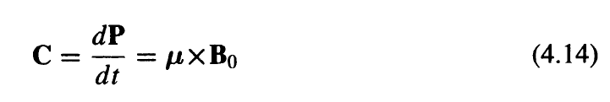
Precessional Frequency
dP
Note: Due to Lorentz Force
dφ
(By (4.13))
(By coupling, µ=γP)
(By definition)

Slide 13
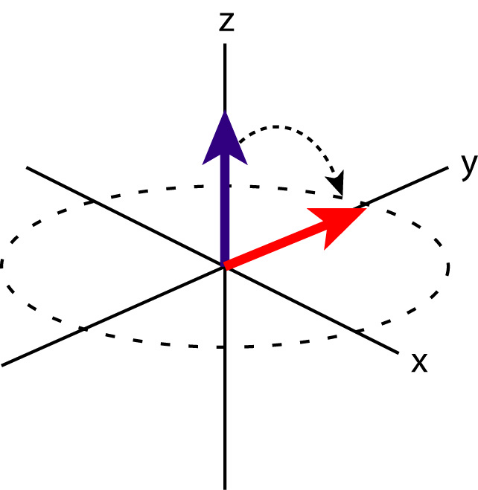
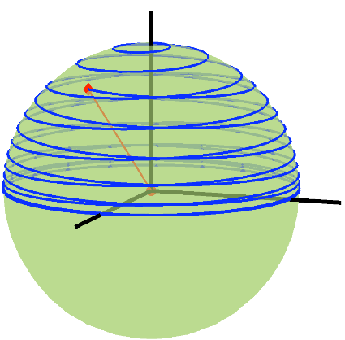
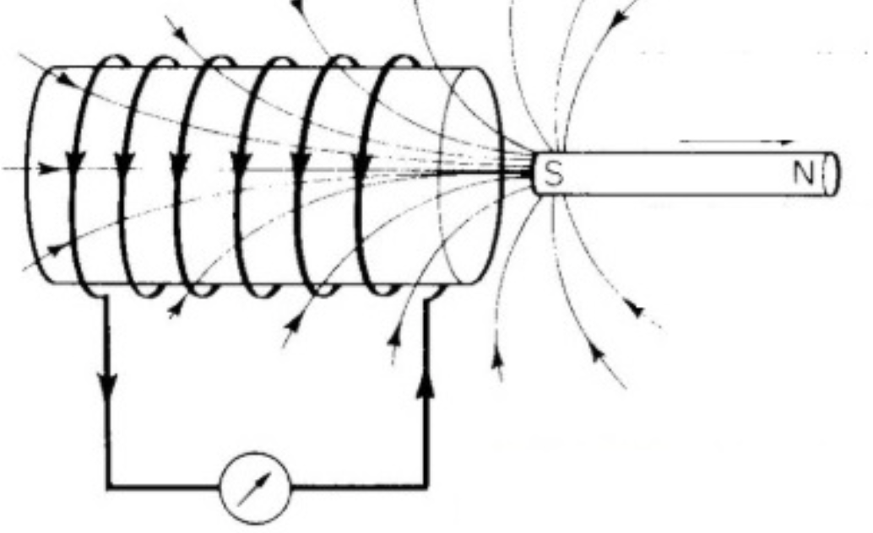
Flipping M in Rotating Frame
If M is flipped, we have a signal!
A rotating magnetic field is needed to flip M!

Slide 14


Slide 15
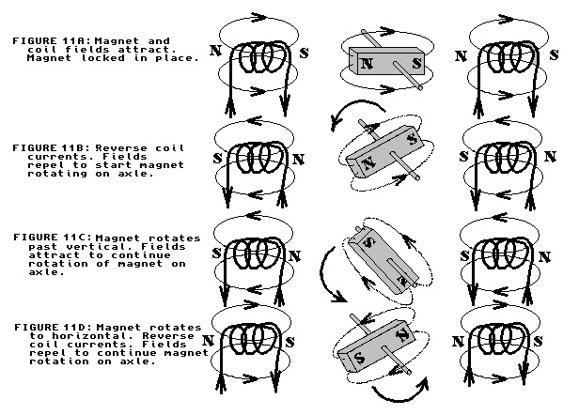
Good Idea: Rotating Magnetic Field

Slide 16
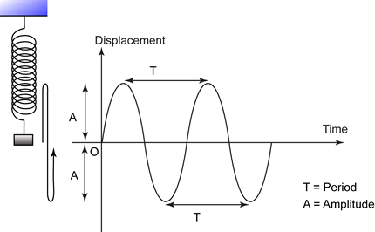
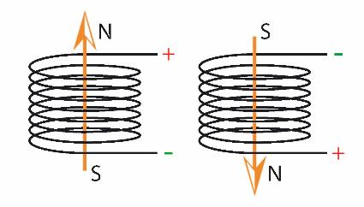
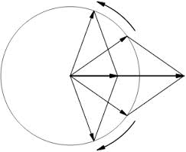
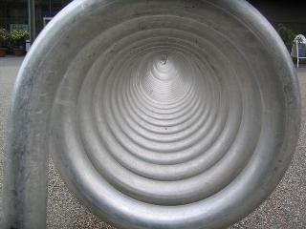
Better Idea: Rotating M Field
Two oppositely rotating vectors of equal amplitude (one of this rotating vectors is in resonance with the precession) These two vectors are added to produce a vector in a fixed direction with an oscillating amplitude (which is what we see nominally).

Slide 17
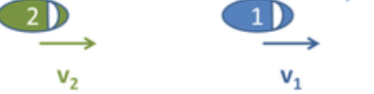
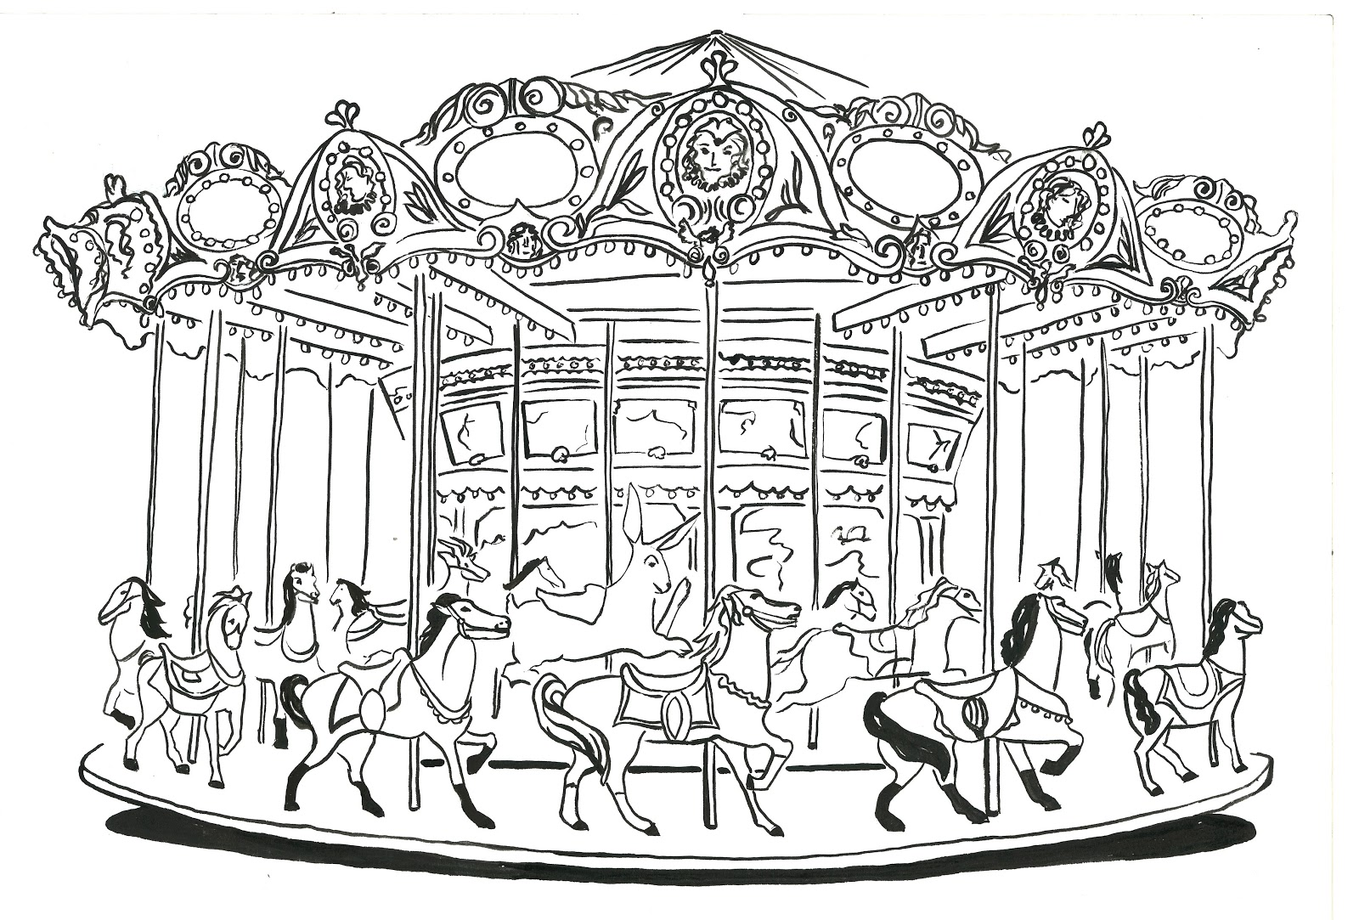
Moving/Rotating Frame

Slide 18
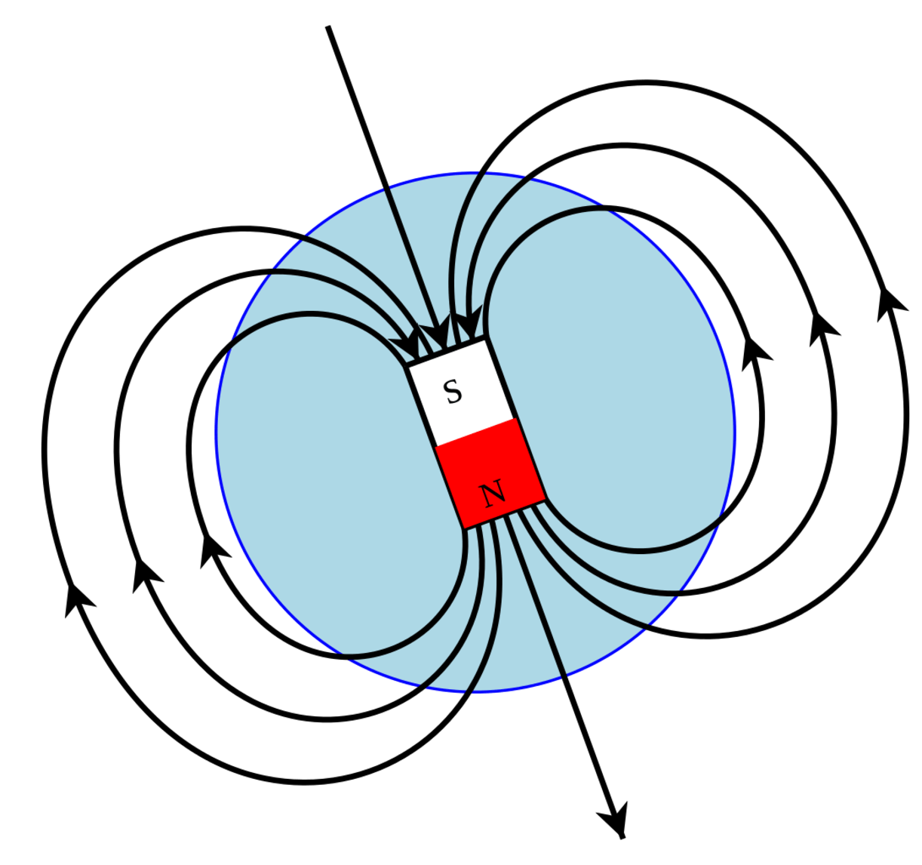
Rotating Magnet = Stationary Field
M
τ = μ X B
B1
B1 is always perpendicular to M so that M is turned into the plane consistently and rapidly (sin=1)

Slide 19
Outline
Magnetization Vector
Bloch Equation, T1 & T2
Spin Echo

Slide 20
Bloch Eqs. in the Rotating Frame

Slide 21
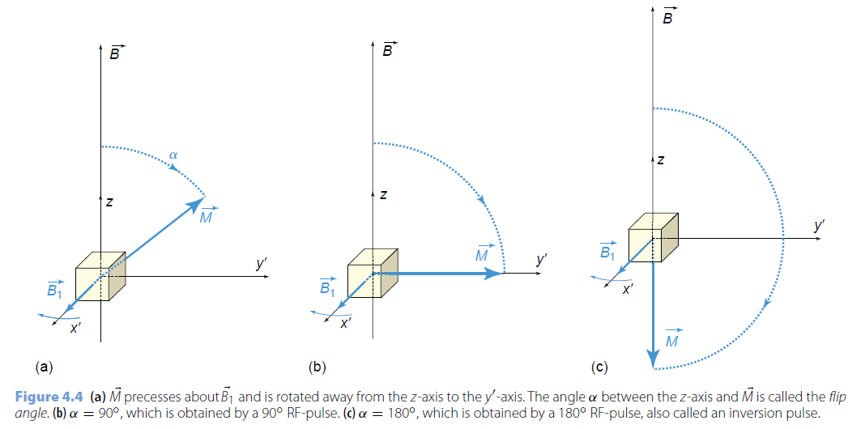
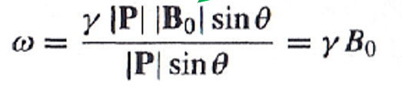
Flip Angle
α = 90° (90°pulse)
α = 180° (180°pulse)
α = ω₁.t = γ B₁.t

Slide 22
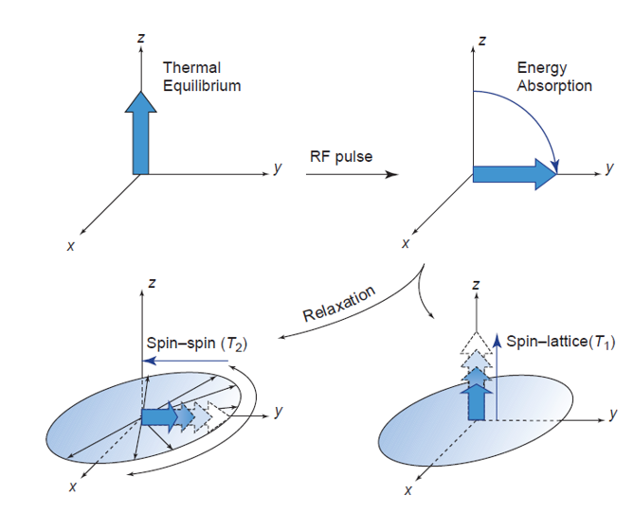
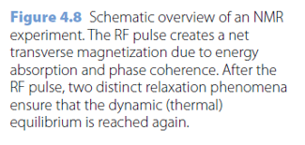
T1 & T2 Relaxation

Slide 23
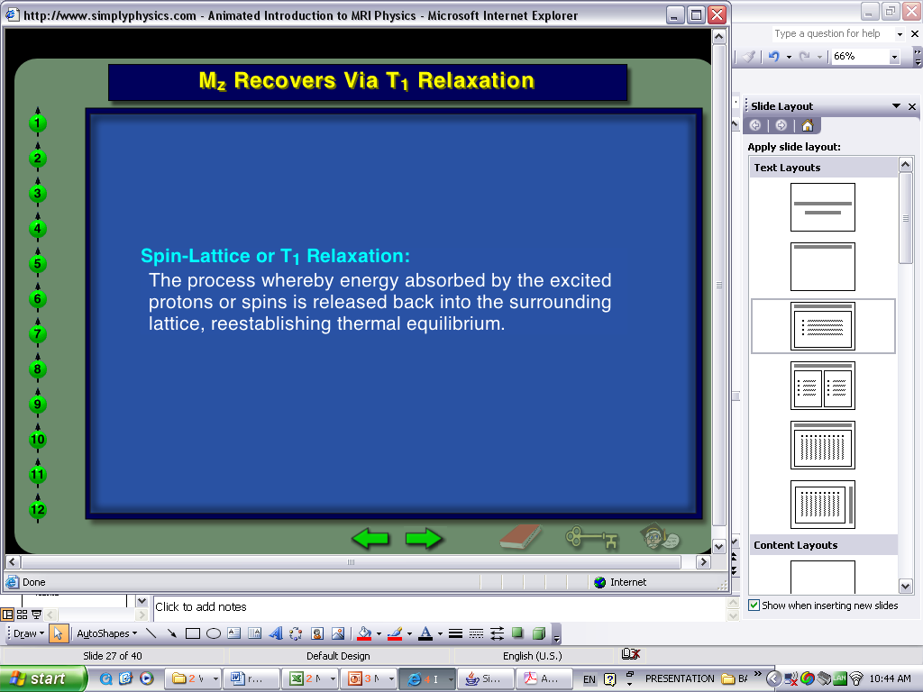
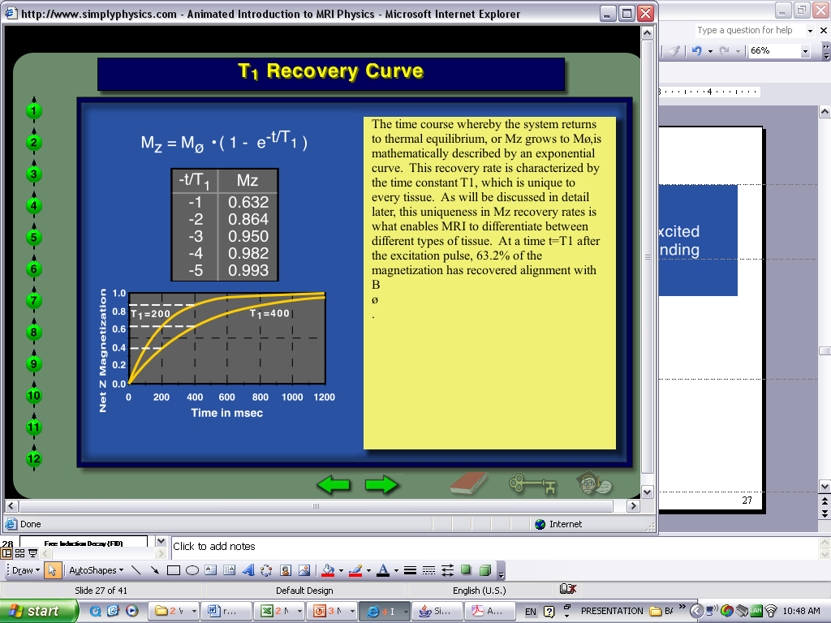
Longitudinal Relaxation (M_{Z})
General Case: M_{z}(t) = M₀[1-exp(-t/T₁)]+M₀cosα exp(-t/T₁)

Slide 24
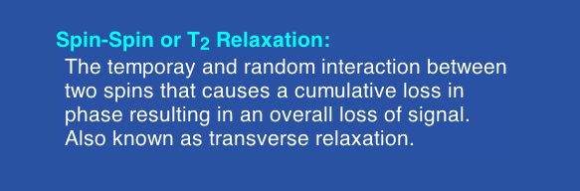
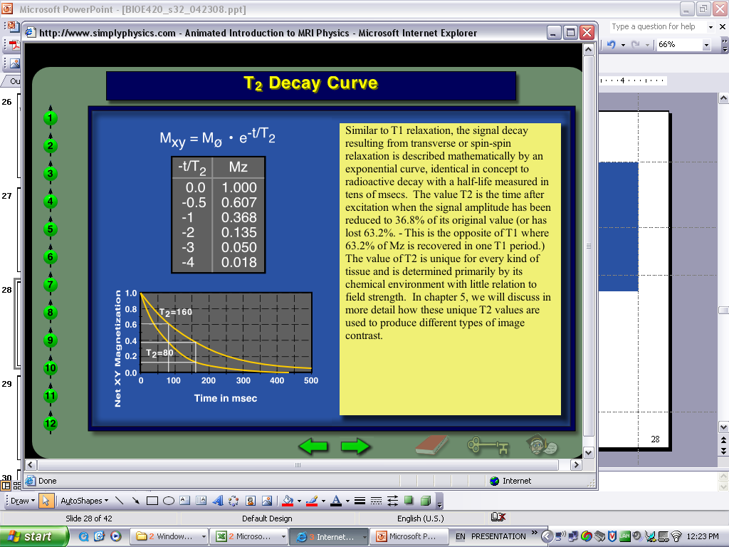
Transverse Relaxation (M_{xy})
General Case: M_{xy}(t) = M₀sinα exp(-t/T₂)

Slide 25
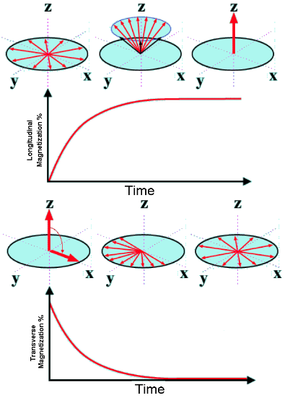
T1 & T2 Relaxation
T1-Relaxation: Recovery
Recovery of longitudinal component of M
T1 time refers to 63% recovery
Spin-Lattice interactions
T2-Relaxation: Dephasing
Loss of transverse magnetization M_{xy}
T2 time’ refers to 37% loss
Spin-spin interactions, and more

Slide 26
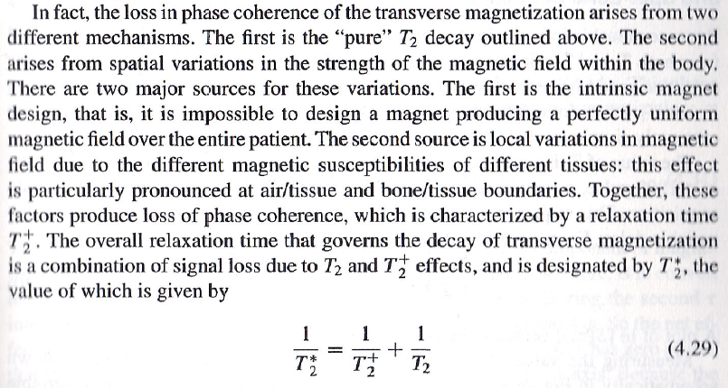
T2⁺ & 2*
Constant Inhomogeneous Magnetic Field
Spin-spin interaction, Time-varying Inhomogeneous Magnetic Field

Slide 27
Outline
Magnetization Vector
Bloch Equation, T1 & T2
Spin Echo

Slide 28
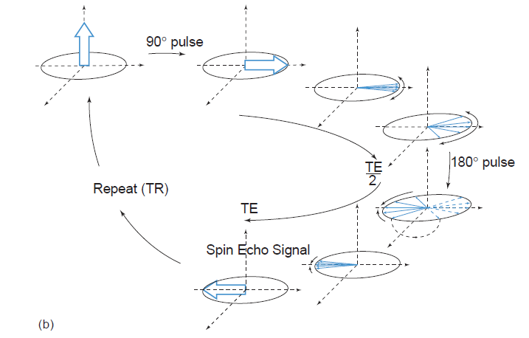
Spin-Echo Idea

Slide 29

Controlled Running
Starting Point
Different Mileage
New Alignment
Direction Change

Slide 30
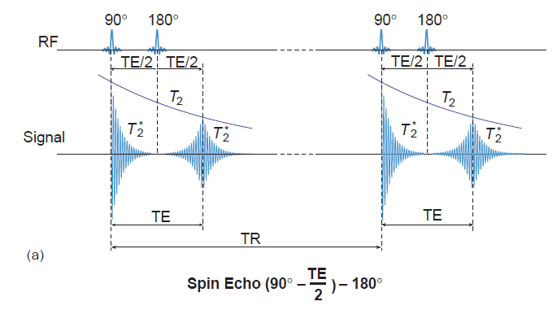
Spin-Echo Signal

Slide 31
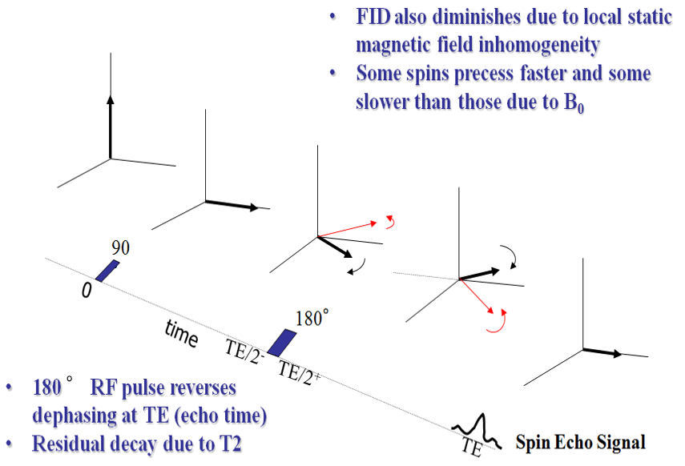
Spin-Echo Variant

Slide 32


Homework
The precessional direction of the magnetic moment on the left is different from what you see in your textbook (right). Which one is correct? Why?

Slide 33



Homework
To explain these soon
As your homework, please explain this slide in your words

